Slide 1
Stray Animal Detection
Rohan Juneja – 51
Om Kakde – 54
Kartikey Dwivedi – 57
Vedant Khandekar - 59
Mandar Kulkarni – 65

Slide 2
Contents
Introduction
Individual Contribution
Algorithms
Methodology
Results
Applications
Conclusion
References

Slide 3
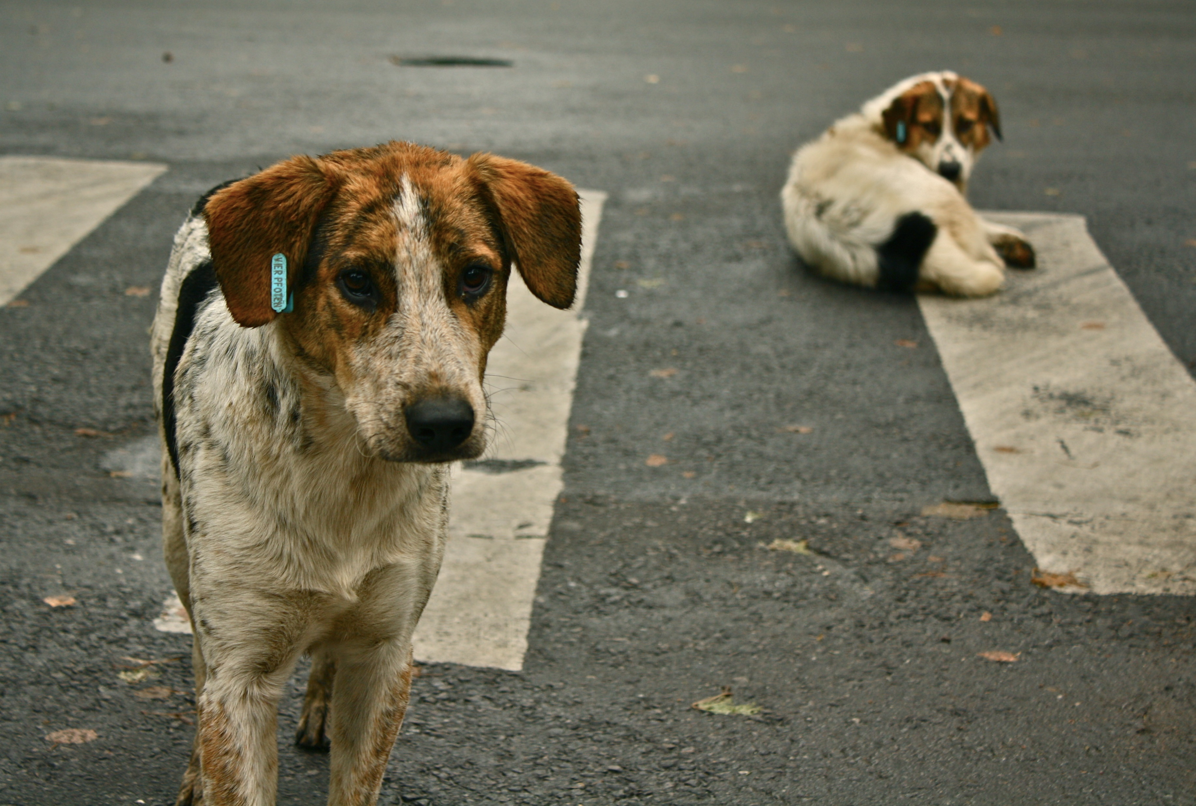
Introduction
Stray animals like dogs, cats can be found on almost everywhere. Our Project aims at detection of these animals to properly locate them and provide them with shelter and food and make sure that they don’t cause any traffic havoc.
India is also known for the maximum number of road accidents in the world. The collision of an animal with the vehicle on the highway is one such big issue, which leads to such road accidents.

Slide 4
Individual Contribution
Om Kakde – Dataset Preparation , SIFT implementation
Vedant Khandekar – Algorithm Finalization , SIFT implementation
Mandar Kulkarni – Algorithm Finalization , KNN implementation
Kartikey Dwivedi – SVM implementation , Model preparation
Rohan Juneja – Testing Model for various images , classification report , SVM implementation

Slide 5
Algorithms
SIFT :
The scale-invariant feature transform (SIFT) is a feature detection algorithm in computer vision to detect and describe local features in images.
K-means :
K-means clustering is one of the simplest and popular unsupervised machine learning algorithms. A cluster refers to a collection of data points aggregated together because of certain similarities.
SVM :
“Support Vector Machine” (SVM) is a supervised machine learning algorithm which can be used for both classification or regression challenges. However, it is mostly used in classification problems. In the SVM algorithm, we plot each data item as a point in n-dimensional space

Slide 6

Methodology
Creating animals dataset
Applying sift feature descriptor
Classification using K means clustering
Applying SVM to create model
Calulating classification report
Testing on different images

Slide 7
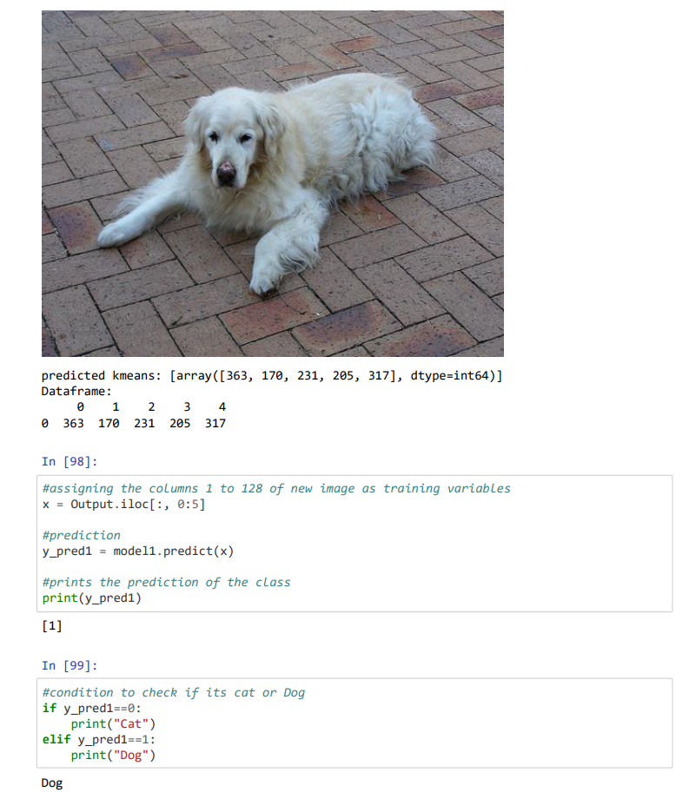
Results

Slide 8
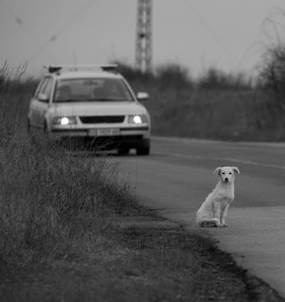
Applications
Stray animals often falls prey to fast moving vehicles which is dangerous for animals as well as the rider, so detection of these animals is important
Lost Animals are difficult to find . If the picture of the animal is known, then detecting similar looking pet in the same area will make it easier to find the pet
Stray Animals especially dogs may have serious diseases like rabies which can be fatal for humans and other animals. Locating such animals is necessary for everyone’s safety. This can be done using the proposed algorithm.

Slide 9
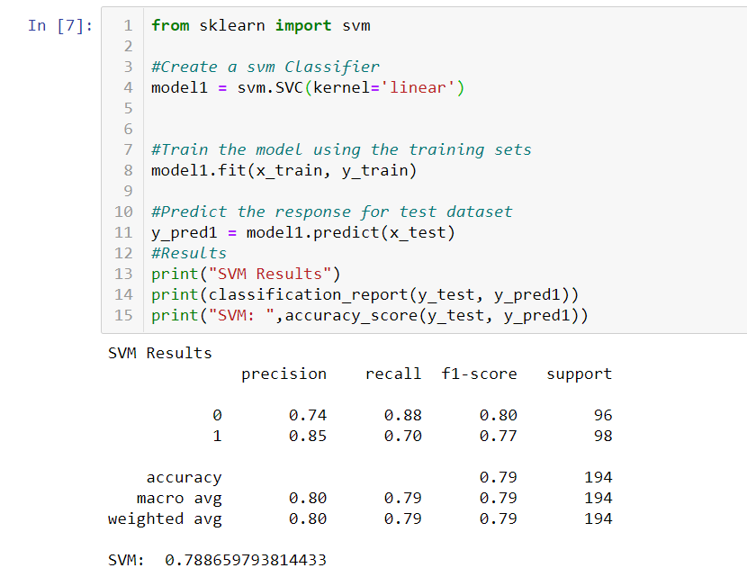
Conclusion
After cropping the animals images we apply feature descriptors like sift to extract the features . Further by the use of unsupervised algorithm like K means clustering we can label our target dataset . The labelled dataset can now be processed using a supervised algorithm like SVM . The dataset contained 500 cat images and 500 dog images . After training the model the accuracy was found to be 85 +- 5 %.

Slide 10
References
https://ieeexplore.ieee.org/stamp/stamp.jsp?arnumber=7792584
http://vision.stanford.edu/aditya86/ImageNetDogs/main.html
https://www.kaggle.com/crawford/cat-dataset
https://medium.com/data-breach/introduction-to-sift-scale-invariant-feature-transform-65d7f3a72d40
https://en.wikipedia.org/wiki/K-means_clustering
https://www.analyticsvidhya.com/blog/2017/09/understaing-support-vector-machine-example-code/
https://opencv.org/

Slide 11
Thank You!

